Slide 1

Ideal locations for new RESTAURANTS IN Denver
IBM CAPSTONE PROJECT
YAHUI ZHU

Slide 2
Background
Denver has been one of the fastest-growing major cities in the United States
Denver is also a jumping-off point for ski resorts in the nearby Rocky Mountains
Opening a new restaurant in Denver is promising and profitable considering the local population and tourists

Slide 3
business problem
Find an ideal place to open a new restaurant in Denver
Identify the best type of restaurant to open in different neighborhoods

Slide 4
methodology
Clustering Denver neighborhoods in order to recommend places to open a restaurant and the type of restaurant in different neighborhoods
Key factors to consider:
number of existing restaurants in the neighborhood
number of distance to other restaurants in the neighborhood
distance of neighborhood from city center

Slide 5
Data source
Google Maps API reverse geocoding: obtain approximate addresses of centers of candidate areas
Foursquare API: obtain detailed information of restaurants in every neighborhoods

Slide 6
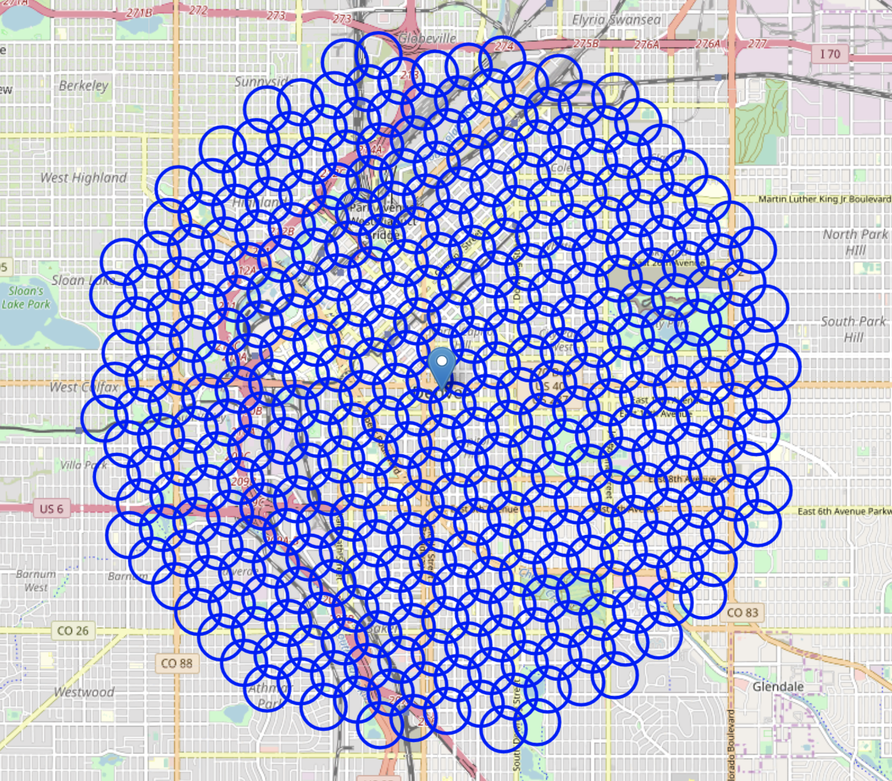
Results - GRID OF LOCATIONS

Slide 7
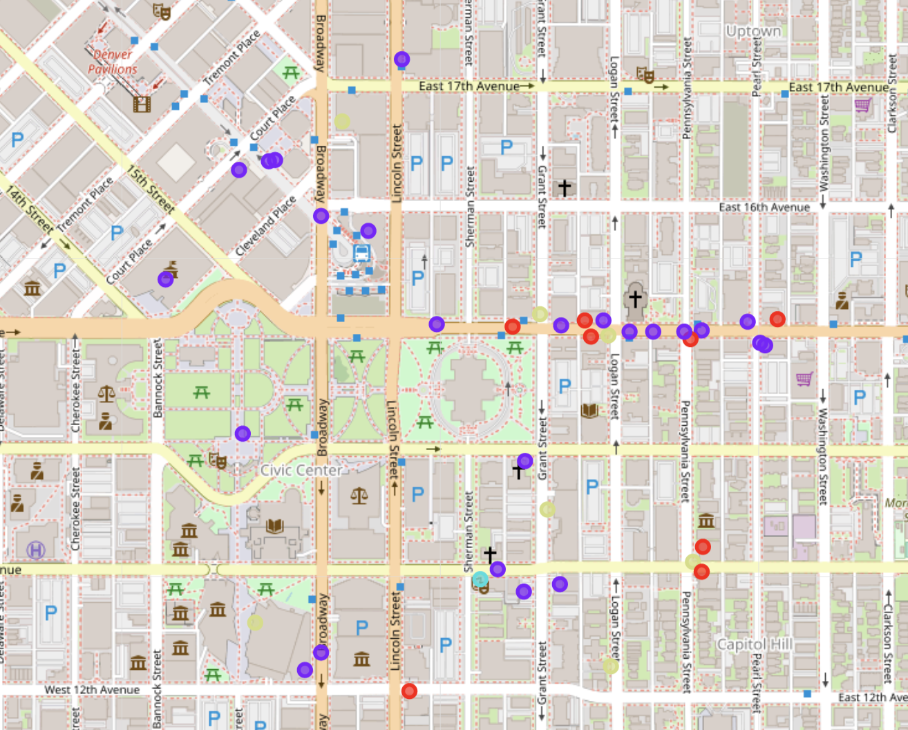
results - Clustering

Slide 8
Results
Cluster 1: Bars and Cafes, good quality food
Cluster 2: Café and India Restaurants, below average quality food
Cluster 3: Vegetarian Restaurants, high quality food
Cluster 4: Mixed Restaurants, moderate quality food

Slide 9
Conclusion
We found four promising restaurant clusters with different food type concentration
Final decision on restaurants should also consider attractiveness of locations, levels of noise/proximity to major roads, distance to resorts, etc.

